Slide 1
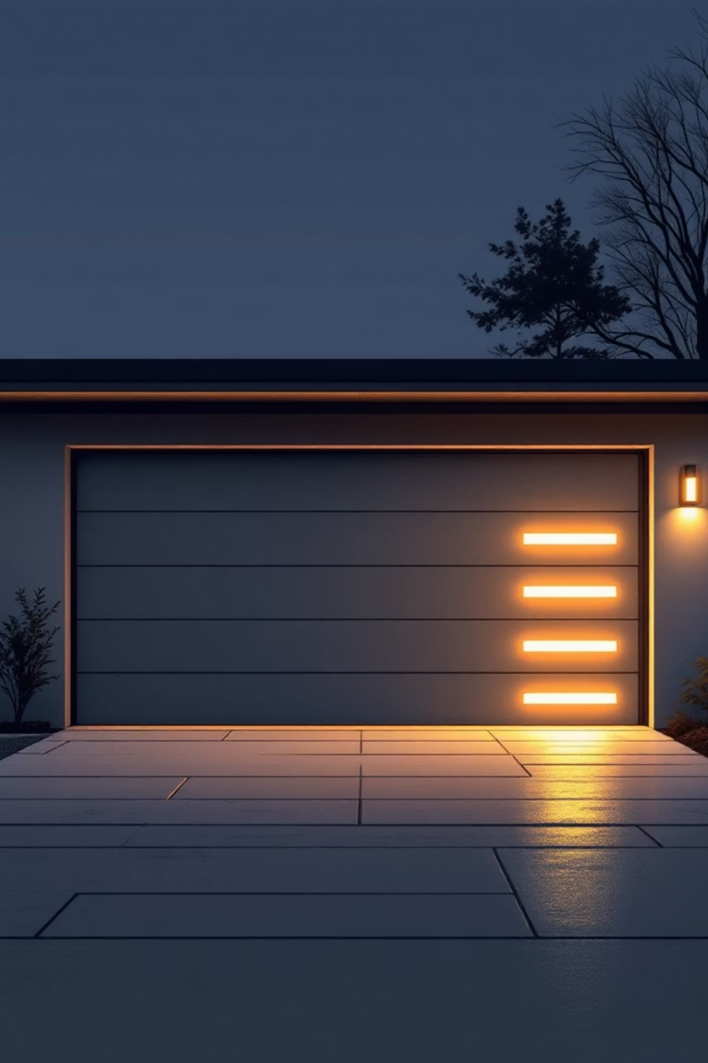
Smart Garage Door Control System
Automated garage access with password security and safety monitoring.
Built with PIC16F877A Microcontroller
Team: Anas Mohammad, Ahmed Elwakil, Hassan Mohammad, Abdulrahman Abo Mostafa, Ahmed Bahnasy, Mostafa Moheb, Ahmed M. Fayad

Slide 2
What We Built
1
2
3
Automatic Door
Secure Entry
Safety First
Opens when car approaches.
4-digit password keypad.
Obstacle detection prevents accidents.
4
5
Easy Exit
Real-time Feedback
Manual button, no password needed.
LCD and LED status indicators.
Core Technology: PIC16F877A microcontroller with state machine control.

Slide 3
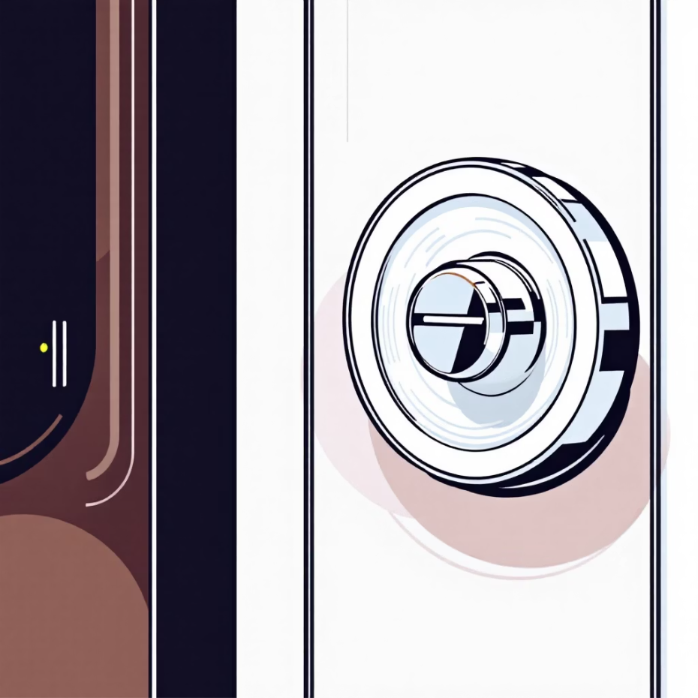

Key Components
Sensing & Input
Control & Output
2× HC-SR04 Ultrasonic Sensors (entry & obstacle)
PIC16F877A Microcontroller (brain)
4×4 Matrix Keypad (password)
SG90 Servo Motor (door mechanism)
Push Button (manual exit)
16×2 LCD Display (user feedback)
Green/Red LEDs (visual status)
Total Cost: ~$30-40 USD | Assembly Time: 2-3 hours

Slide 4



How It Works
Entry Mode
Exit Mode
Car detected (25cm)
Press EXIT button
Enter 4-digit password
Door opens immediately
Door opens to 90°
Car clears, door auto-closes
Car passes, door auto-closes
Total cycle time: 20-30 seconds

Slide 5

Built-in Protection
Password Security
Physical Safety
4-digit authentication
Inner sensor (15cm threshold)
3 failed attempts → 60-sec lockout
Door stops if obstacle detected
Real-time countdown
10-second open timeout
Edge Case Handling: System remains safe even with sensor failures.

Slide 6
Software Architecture
Control Strategy: State Machine
IDLE
DETECTION
PASSWORD CHECK
DOOR OPENING
WAITING FOR PASSAGE
DOOR CLOSING
Key Algorithms
Ultrasonic distance: (echo_time × 0.0343) / 2
Servo PWM control: 50 iterations @ 20ms
Password validation & tracking
Resource Usage: 52% RAM | 31% ROM

Slide 7
Microcontroller Interface
PORTB
Keypad Matrix
RB0-RB3 (cols), RB4-RB7 (rows)
PORTC
Sensors + Servo
RC0-RC1 (outer), RC2-RC3 (inner), RC4 (PWM)
PORTD
LCD Data Bus
RD2 (RS), RD3 (EN), RD4-RD7 (D4-D7)
PORTE
Status + Button
RE0 (green), RE1 (red), RE2 (button)
Power Requirements: 5V DC @ 2A (servo peak: 500mA)

Slide 8


Multi-Layer Protection
Obstacle Detection
Timeout Protection
Inner sensor (<15cm) stops door closing. Door waits for clear path.
10-second window for passage. Auto-recovery to safe state.
Lockout System
Prevents brute-force password attacks.

Slide 9
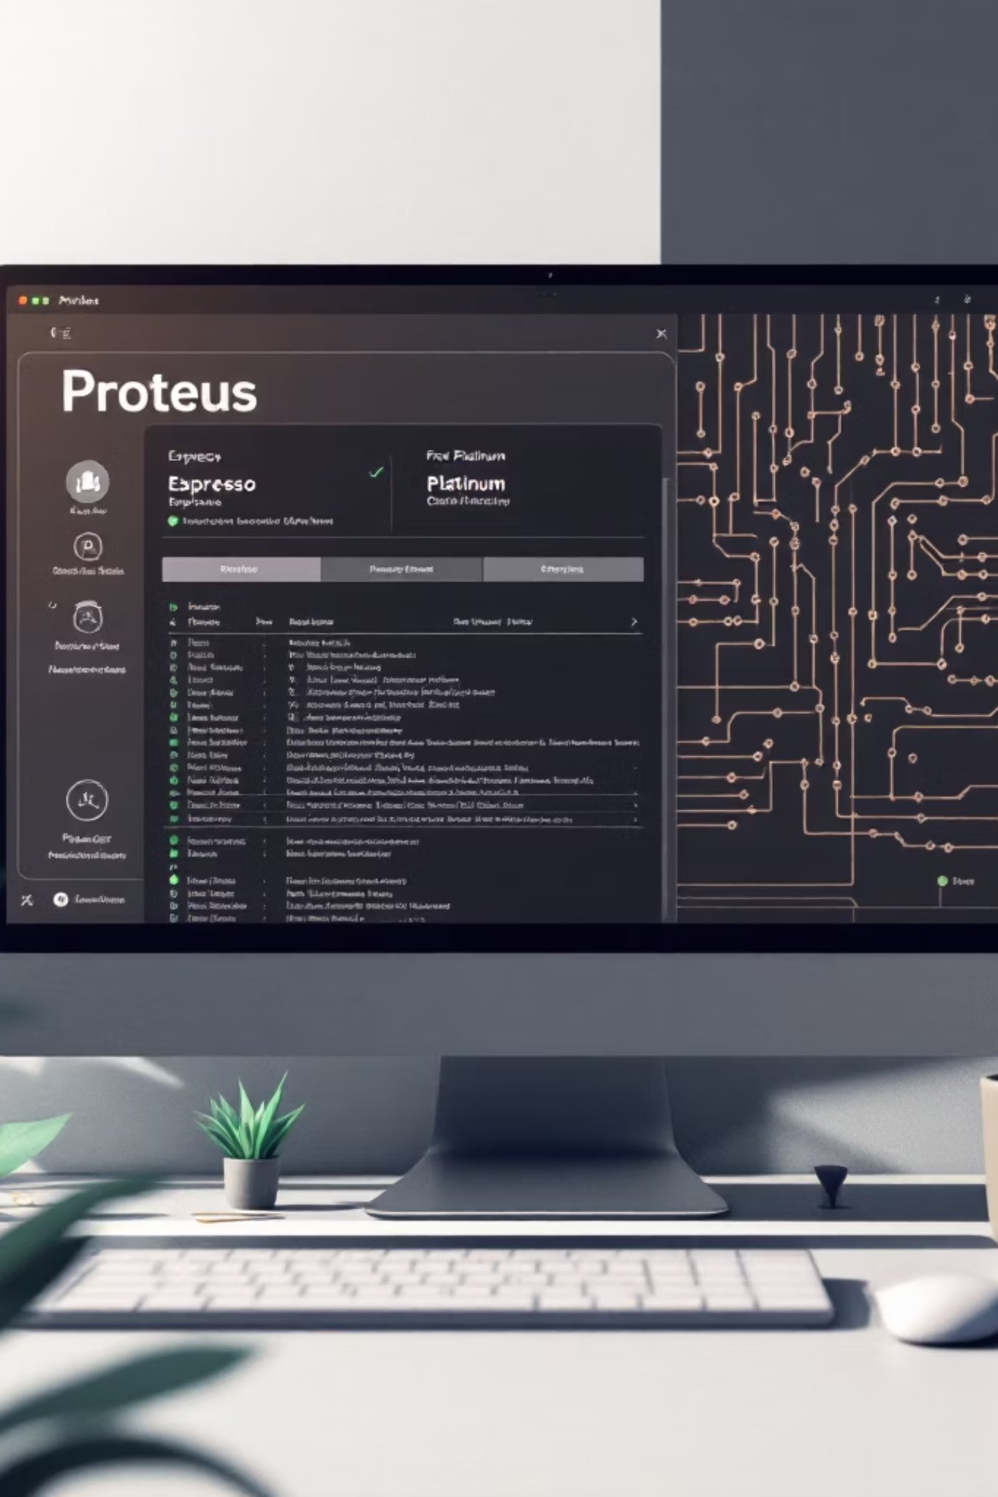
Validation Results
Proteus Simulation
Performance Metrics
✓ Full system verified
Detection: 2-400cm range
✓ All components responsive
Door operation: ~5 seconds
✓ Edge cases tested
Response time: <100ms
Hardware Status: Fully functional on breadboard prototype.

Slide 10

Project Highlights
Achieved
Complete embedded system
Real-world safety features
Modular code architecture
Production-ready docs
Future Enhancements
RFID card access
Bluetooth/Wi-Fi control
Multi-user password
Entry/exit logging
Repository: https://github.com/AnasMohamed7/Smart_Garage.git

